Slide 1


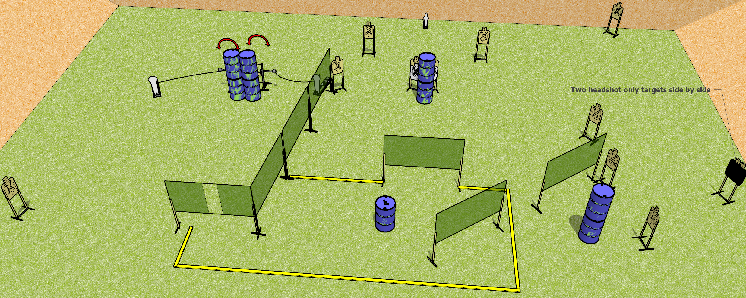
 | Dothan Gun Club – USPSA Match Grab that Gun Course Designer : Drew Coleman
START POSITION : Outside the shooting area
GUN READY CONDITION : Firearm loaded, safety on, muzzle pointed perpendicular to the back berm, placed unsupported on barrel in center of shooting area. |  | SCORING: Comstock, 31 rounds TARGETS: 14 paper, 3 Steel SCORED HITS: Best 2 on paper, steel until down START-STOP: Audible, last shot RULES:
STAGE PROCEDURE: Engage targets as they become available from within the fault lines.

Slide 2
Grab that Gun
Written Stage Briefing
Grab that Gun is a 31 round, 155 point, Comstock field course. There are fourteen USPSA targets, two Colt poppers, and one mini popper. The best two hits on paper will score, and steel must fall to score. The start signal is audible.
The left swinger is activated by the left Colt popper, and the right swinger is activated by the right Colt popper. Please check the activators prior to walkthrough and set the same way every time.
Start position is outside the shooting area. Firearm is laying unsupported on barrel in the shooting area, loaded, safety on, muzzle perpendicular to the back berm.
On start signal engage targets as they become available from within the shooting area.

